Slide 1

INVESTIGATE MAGENTO 2 Performance
Chau Thanh Nhan 11-22-2016

Slide 2
Objective
Define the measure of performance tuning
Get support tool
Get performance test scenarios
Make performance reports

Slide 3
Requirements
Javascript/CSS
PHP language
Database-Mysql
Magento 2

Slide 4
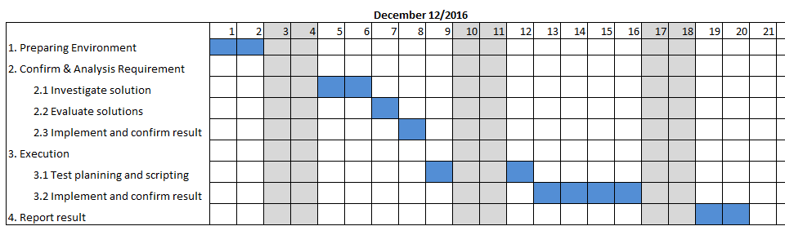
Plan
Effort: 14MD
Person in charge: Le Hai Dang

Slide 5
Preparing Environment
Build the development environment for investigation

Slide 6
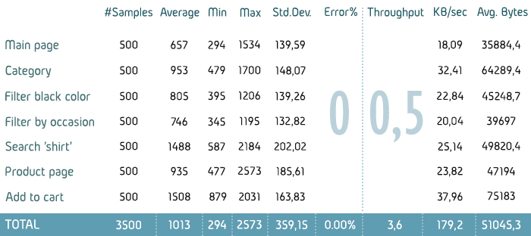
Confirm & Analysis Requirement
Define measure methods of performance: page load time, execute time, response time.
Get the support tool for executing measure.
Sample

Slide 7
Execution
Make Performance test scenarios with 10/20 users
Main Page
Category
Product Page
Search Page
Add to Cart
Execute the scenarios

Slide 8
Report
Get the report about performance tuning

Slide 9
The end

